Slide 1

This Experiment Was Created Using

Slide 2
Welcome!
PRESS THE SPACEBAR TO CONITUE

Slide 3






Instructions
In this experiment, you will be placed into a 3D environment and your task is to find and collect the following items as fast as you can! To collect an item simply walk into it. When you collect and item you will hear the item’s sound.
Chomp!
Cha-ching!
Gulp!

Slide 4
Find Both!

Slide 5
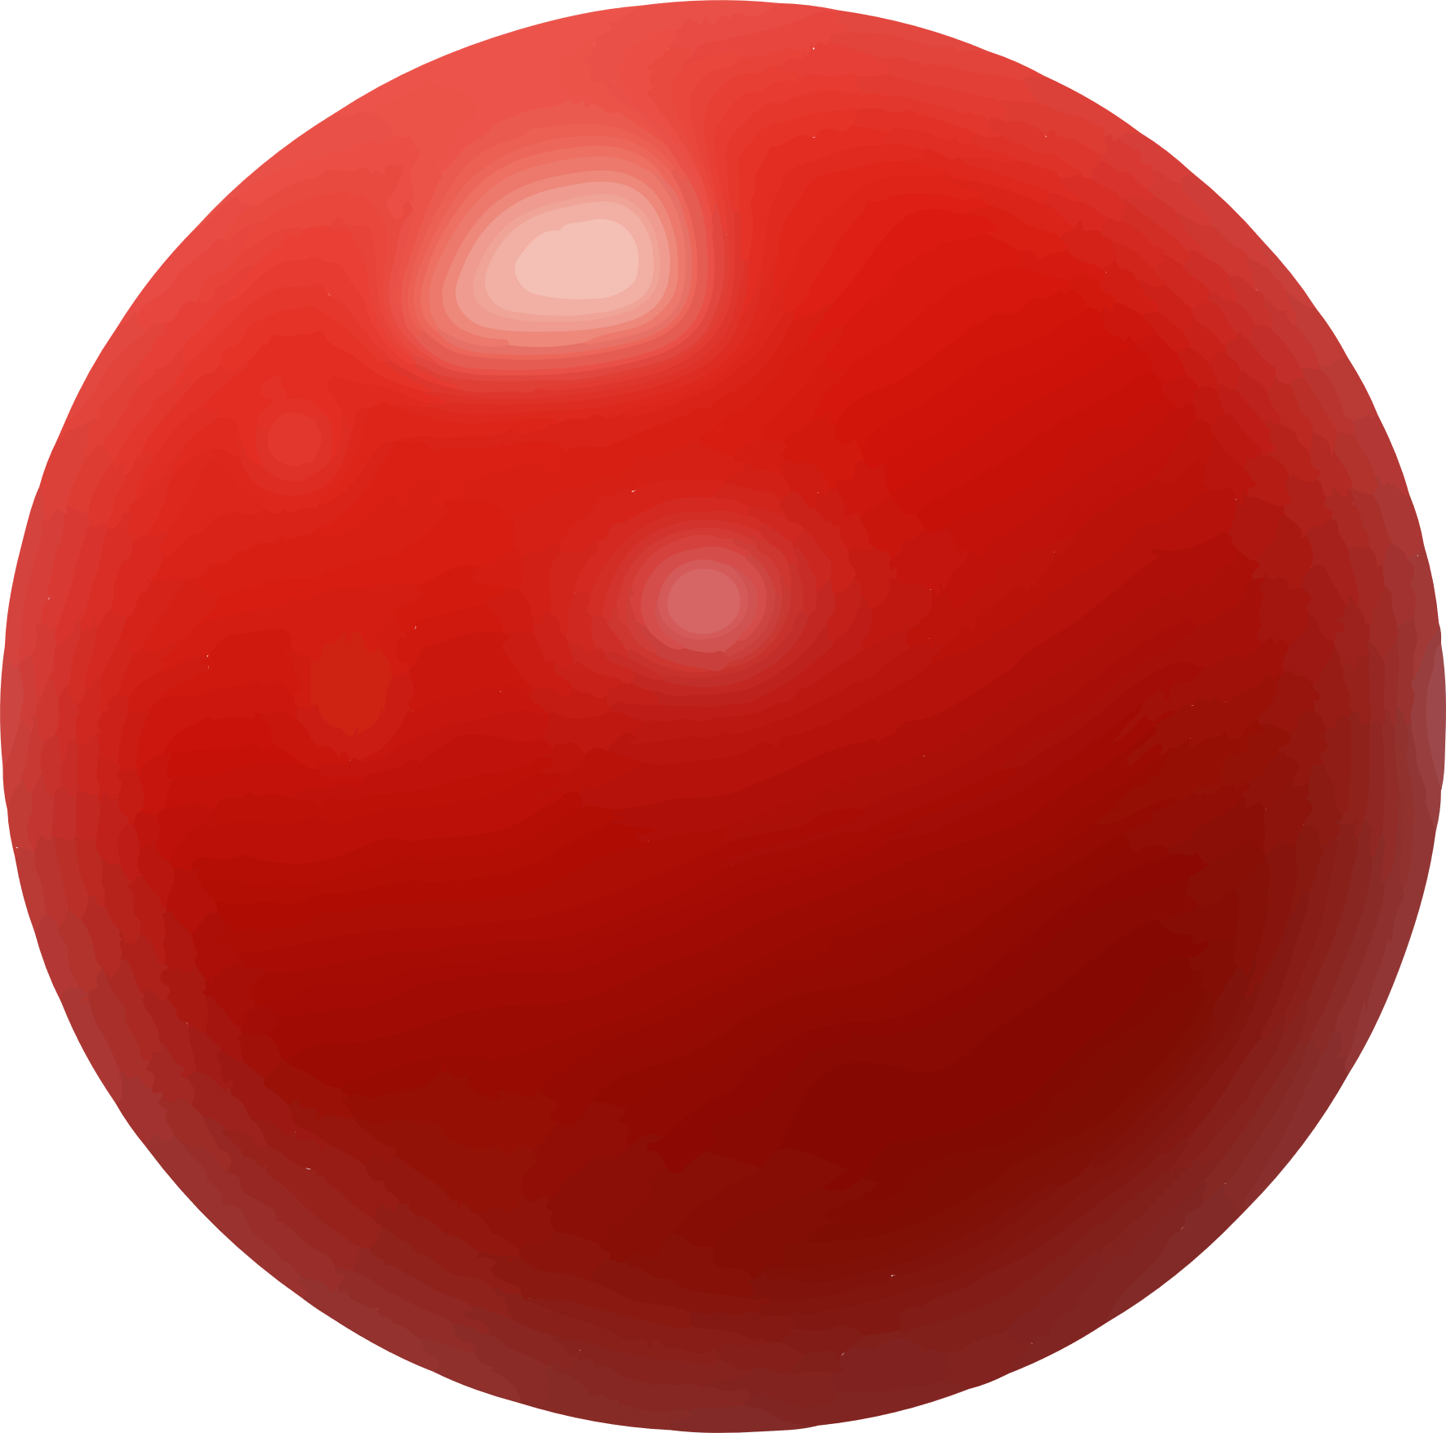
Collect

Slide 6

MOVEMENT CONTROLS
To navigate the environment, use the Up-Arrow to move forward, the Down-Arrow to move backwards and the Left-Arrow and Right-Arrow to rotate.
Move Forward
Rotate
Left
Rotate
Right
Move Backward
PRESS THE SPACEBAR TO CONITUE

Slide 7
MOVEMENT CONTROLS
To navigate the environment, use the Up-Arrow to move forward, the Down-Arrow to move backwards and the Left-Arrow and Right-Arrow to rotate.
Move Forward
Rotate
Left
Rotate
Right
Move Backward

Slide 8
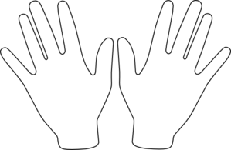
Get Ready!
Spacebar
Place your right hand on the arrow keys and press the Spacebar with your left to continue!

Slide 10
Collect the Items!

Slide 11
Find

Slide 12
Find

Slide 13
Find

Slide 14
You’ve Completed the Experiment! Note: The End Experiment button will not end the experiment if you’re running it in the Unity Editor. Press the button at the top of the editor to end the experiment.

Slide 15
Locate the Cube!! Note: Sometimes it will be invisible!

